Slide 1
DATA SCIENCE
Data science is an interdisciplinary field that uses scientific methods, processes, algorithms and systems to extract knowledge and insights from noisy, structured and unstructured data and apply knowledge and actionable insights from data across a broad range of application domains. Data science is related to data mining, machine learning and big data.

Slide 2
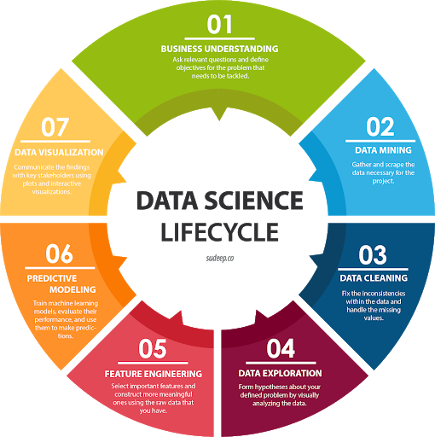

Slide 3
Data science is a "concept to unify statistics, data analysis, informatics, and their related methods" in order to "understand and analyze actual phenomena" with data. It uses techniques and theories drawn from many fields within the context of mathematics, statistics, computer science, information science, and domain knowledge. However, data science is different from computer science and information science. Turing Award winner Jim Gray imagined data science as a "fourth paradigm" of science (empirical, theoretical, computational, and now data-driven) and asserted that "everything about science is changing because of the impact of information technology" and the data deluge
A data scientist is someone who creates programming code, and combines it with statistical knowledge to create insights from data.

Slide 4
DATA SCIENCE APPLICATIONS AND EXAMPLES
Identifying and predicting disease
Personalized healthcare recommendations
Optimizing shipping routes in real-time
Getting the most value out of soccer rosters
Finding the next slew of world-class athletes
Stamping out tax fraud
Automating digital ad placement
Algorithms that help you find love
Predicting incarceration rates

Slide 5
Data science is a multidisciplinary approach to extracting actionable insights from the large and ever-increasing volumes of data collected and created by today’s organizations. Data science encompasses preparing data for analysis and processing, performing advanced data analysis, and presenting the results to reveal patterns and enable stakeholders to draw informed conclusions.

Slide 6
Data preparation can involve cleansing, aggregating, and manipulating it to be ready for specific types of processing. Analysis requires the development and use of algorithms, analytics and AI models. It’s driven by software that combs through data to find patterns within to transform these patterns into predictions that support business decision-making. The accuracy of these predictions must be validated through scientifically designed tests and experiments. And the results should be shared through the skillful use of data visualization tools that make it possible for anyone to see the patterns and understand trends.

Slide 7
As a result, data scientists (as data science practitioners are called) require computer science and pure science skills beyond those of a typical data analyst. A data scientist must be able to do the following:
Apply mathematics, statistics, and the scientific method
Use a wide range of tools and techniques for evaluating and preparing data—everything from SQL to data mining to data integration methods
Extract insights from data using predictive analytics and artificial intelligence (AI), including machine learning and deep learning models

Slide 8
DATA SCIENCE LIFE CYCLE
The data science lifecycle—also called the data science pipeline—includes anywhere from five to sixteen (depending on whom you ask) overlapping, continuing processes. The processes common to just about everyone’s definition of the lifecycle include the following:
Capture: This is the gathering of raw structured and unstructured data from all relevant sources via just about any method—from manual entry and web scraping to capturing data from systems and devices in real time.
Prepare and maintain: This involves putting the raw data into a consistent format for analytics or machine learning or deep learning models. This can include everything from cleansing, deduplicating, and reformatting the data, to using ETL (extract, transform, load) or other data integration technologies to combine the data into a data warehouse, data lake, or other unified store for analysis.

Slide 9
Preprocess or process: Here, data scientists examine biases, patterns, ranges, and distributions of values within the data to determine the data’s suitability for use with predictive analytics, machine learning, and/or deep learning algorithms (or other analytical methods).
Analyze: This is where the discovery happens—where data scientists perform statistical analysis, predictive analytics, regression, machine learning and deep learning algorithms, and more to extract insights from the prepared data.
Communicate: Finally, the insights are presented as reports, charts, and other data visualizations that make the insights—and their impact on the business—easier for decision-makers to understand. A data science programming language such as R or Python (see below) includes components for generating visualizations; alternatively, data scientists can use dedicated visualization tools.

